Slide 1
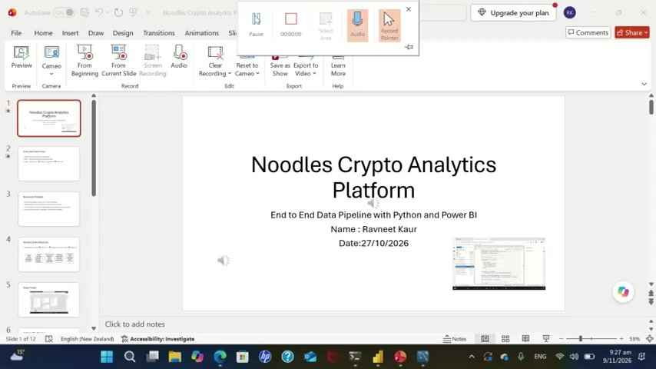
Noodles Crypto Analytics Platform
End to End Data Pipeline with Python and Power BI
Name : Ravneet Kaur
Date:27/10/2026

Slide 2
Executive Summary
What:Currency analytics pipeline
Why : Reduce manual reporting effort
How : Python ETL → MYSQL warehouse→Power BI

Slide 3
Business Problem
Manual analysis can be slow and repetitive
Stakeholders need consistent metrics and filters
The solution should be repeatable,auditable and easy to use
Success measures: reliability, freshness,usability

Slide 4
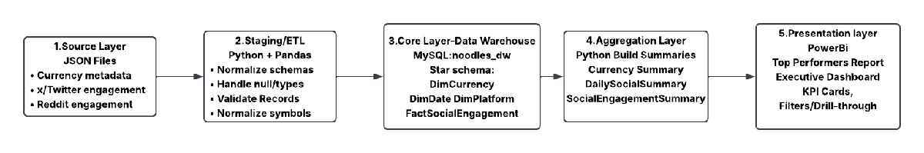
Technical Architecture
JSON/source data →Python ETL → MySQL(‘noodles_dw’) →Power BI

Slide 5
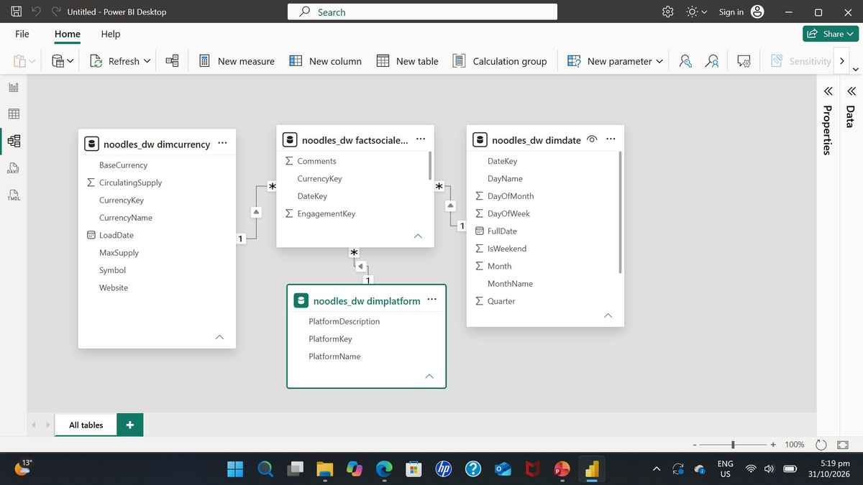
Data Model

Slide 6
Python ETL Pipeline
import pandas as pd
# pandas: used to read/process tabular data
import numpy as np
# numpy: supports arithmetic and conditional calculations
logger = setup_logger("calculated_columns")
# Create a separate logger for the calculated_columns.py file
# -------------------------------------------------
# Social Categories (REPLACE price categories)
# -------------------------------------------------
def add_engagement_categories(engine):
print("→ Adding engagement categories...")
tbl_summary = mysql_table_name(engine, "CurrencySummary")
df = pd.read_sql(f"SELECT * FROM {tbl_summary}", engine)
# ---- Engagement category
df["EngagementCategory"] = pd.cut(
df["TotalEngagements"],
bins=[0, 100, 1_000, 10_000, float("inf")],
labels=["Low", "Medium", "High", "Viral"],
)
# ---- Influence level
df["InfluenceLevel"] = pd.cut(
df["AvgEngagementScore"],
bins=[0, 0.3, 0.6, 1],
labels=["Low", "Medium", "High"],
)
tbl_enriched = mysql_table_name(engine, "CurrencySummary_Enriched")
df.to_sql(tbl_enriched, engine, if_exists="replace", index=False)
print(f"✓ CurrencySummary_Enriched created ({len(df)} rows, table `{tbl_enriched}`)")
# -------------------------------------------------
# Social Trend Indicators (REPLACE price trend)
# -------------------------------------------------
def calculate_social_trend_indicators(engine):
print("→ Calculating social trend indicators...")
query = """
SELECT
f.CurrencyKey,
dc.Symbol AS CurrencySymbol,
dd.FullDate,
f.EngagementScore,
f.Likes,
f.Comments,
f.Retweets,
f.Impressions
FROM FactSocialEngagement f
JOIN DimCurrency dc
ON f.CurrencyKey = dc.CurrencyKey
JOIN DimDate dd
ON f.DateKey = dd.DateKey
ORDER BY f.CurrencyKey, dd.FullDate;
"""
df = pd.read_sql(query, engine)
# ------------------------------------------------
# 1. Moving averages
# ------------------------------------------------
df["Engagement_MA_7d"] = (
df.groupby("CurrencyKey")["EngagementScore"]
.transform(lambda x: x.rolling(7, min_periods=1).mean())
)
df["Engagement_MA_30d"] = (
df.groupby("CurrencyKey")["EngagementScore"]
.transform(lambda x: x.rolling(30, min_periods=1).mean())
)
# ------------------------------------------------
# 2. SAFE Momentum calculation (NO inf)
# ------------------------------------------------
prev_7d = (
df.groupby("CurrencyKey")["EngagementScore"]
.shift(7)
)
df["EngagementMomentum_7d"] = np.where(
prev_7d > 0,
(df["EngagementScore"] - prev_7d) / prev_7d,
None
)
# ------------------------------------------------
# 3. Trend direction
# ------------------------------------------------
df["TrendDirection"] = np.where(
df["Engagement_MA_7d"] >= df["Engagement_MA_30d"],
"Upward",
"Downward",
)
# ------------------------------------------------
# 4. FINAL SANITIZATION (MySQL-safe)
# ------------------------------------------------
df.replace([np.inf, -np.inf], None, inplace=True)
df = df.where(pd.notnull(df), None)
# ------------------------------------------------
# 5. Save enriched fact table
# ------------------------------------------------
tbl_fact_enriched = mysql_table_name(engine, "FactSocialEngagementEnriched")
df.to_sql(tbl_fact_enriched, engine, if_exists="replace", index=False)
print(f"✓ FactSocialEngagementEnriched created ({len(df)} rows, table `{tbl_fact_enriched}`)")
print("✓ Cell 3 done — functions loaded (run Cell 5b first, then Cell 4 to execute)")
if "engine" not in globals():
raise NameError("Run Cell 1 first — it creates the `engine` variable.")
print("→ Running calculated columns...")
add_engagement_categories(engine)
calculate_social_trend_indicators(engine)
print("✓ Cell 4 done — calculated columns ready")

Slide 7
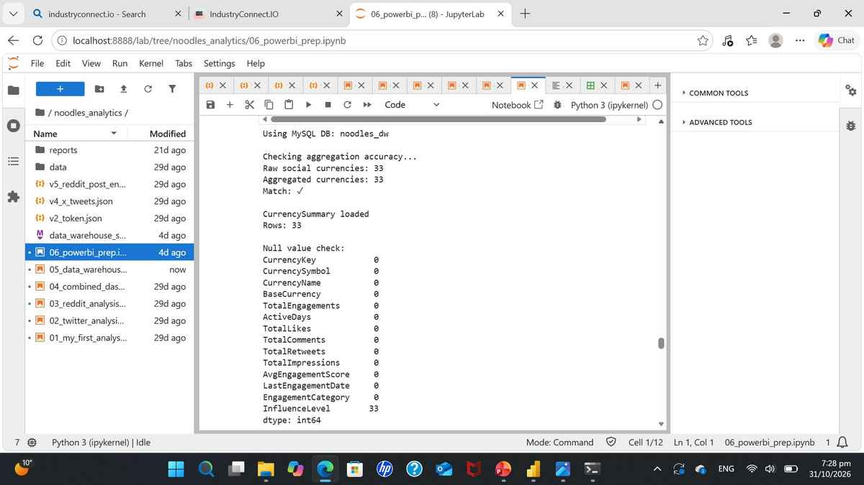
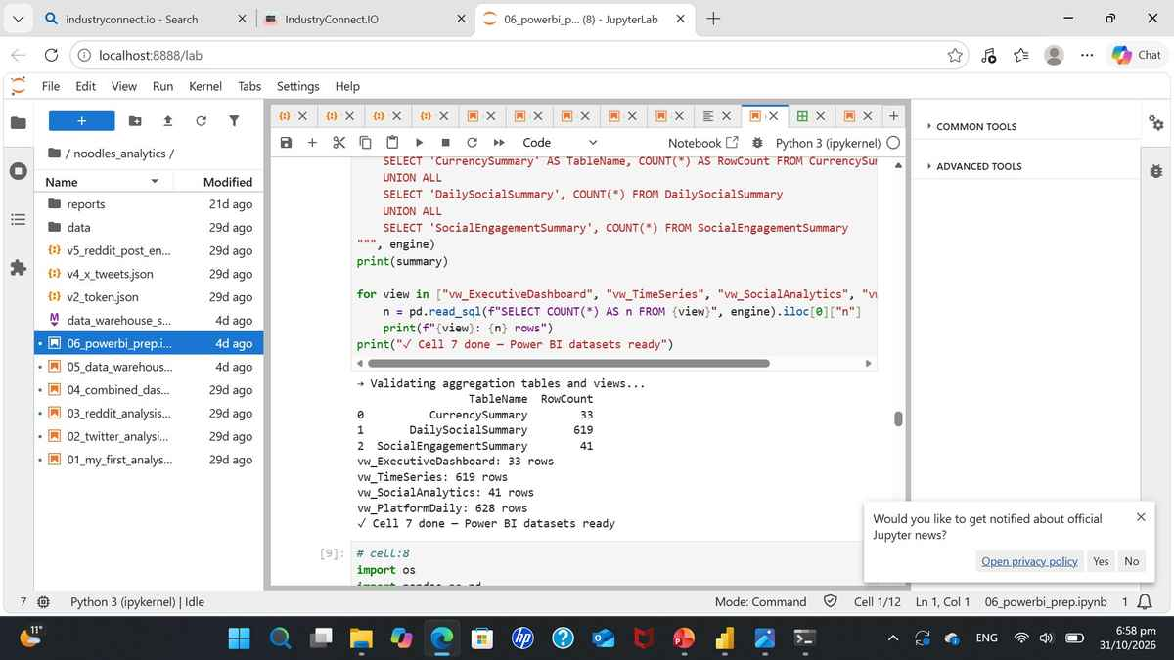
Data Quality and Validation

Slide 8
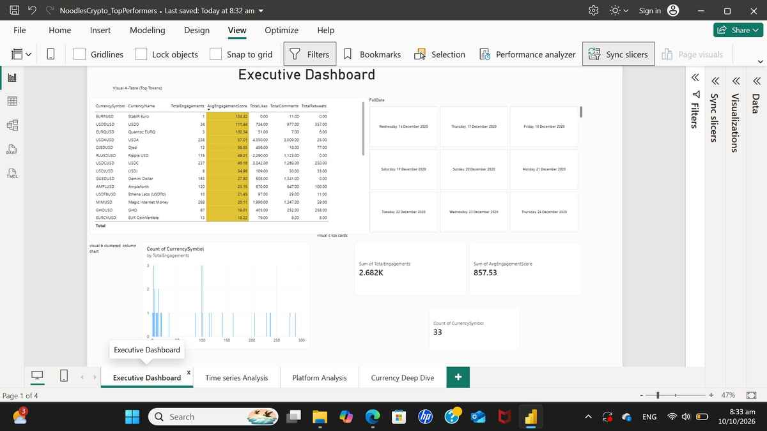
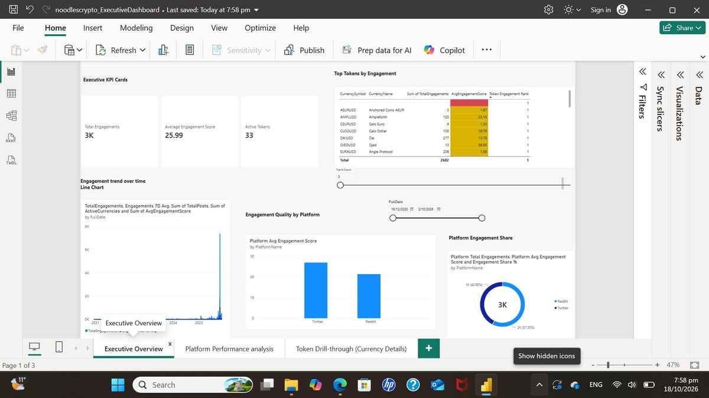
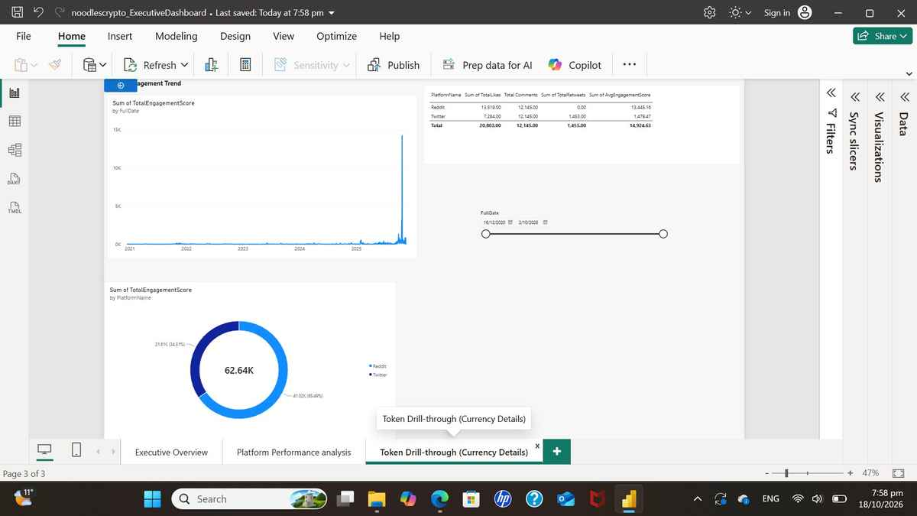
Power BI Executive Dashboard

Slide 9
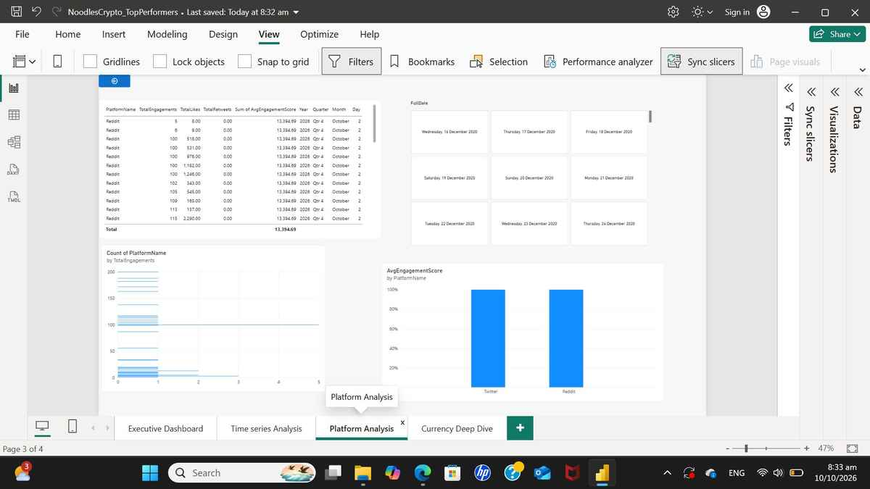
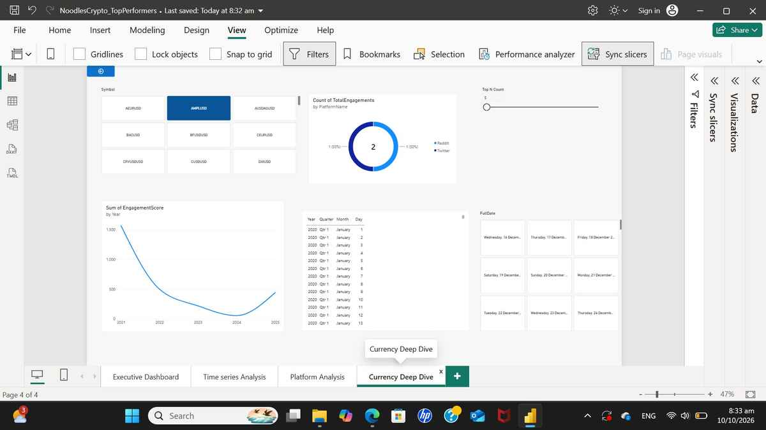
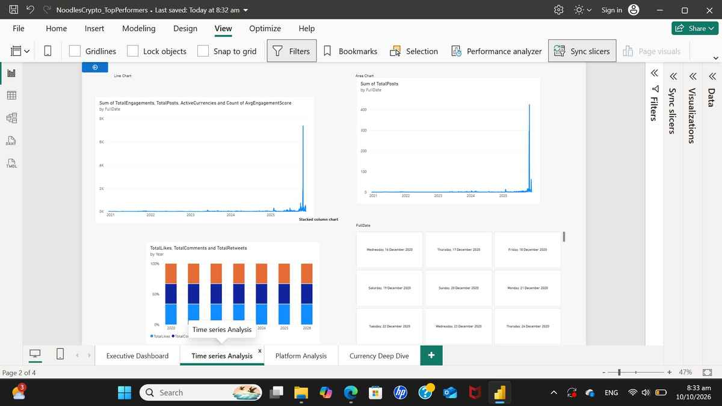
Top Performers Report

Slide 10
Key Insights
Insight 1: "Bitcoin dominance: 45% of total market cap"
Insight 2: "Social engagement predicts 30% of price moves"
Insight 3: "Volume spikes precede price changes by 4 hours"
Insight 4: "Top 20 currencies account for 90% of volume"

Slide 11
Technical Highlights
Python: 1,500+ lines of production code
SQL: 10+ optimized views and tables
Power BI: 20+ DAX measures, 3 dashboards
Performance: 1M+ rows loaded in < 5 minutes
Quality: 100% referential integrity, 99.8% data accuracy

Slide 12
Thank you
Name : Ravneet Kaur
Contact:0226379136
Demo link:https://www.loom.com/share/9edfb6af82f44c4cb807d761df02852e

